Slide 1
CS5100: Foundations of Artificial Intelligence Adversarial Search
Dr. Rutu Mulkar-Mehta
Lecture 4
Some slides and images used from Berkeley CS188 course notes, with permission
Some slides and images used from Cornell CS4700 course notes, with permission

Slide 2
Administrative
Extra Credit Assignment:
Was due at 6:00PM today on Gradescope
Assignment 1 solutions are graded and returned to you
Project 1:
Due on 10/06
Submission instructions:
Please email your solutions to:
Professor: me@rutumulkar.com
TA: k.porterfield7@gmail.com
Subject: [PROJECT 1] <FirstName> <LastName>

Slide 3
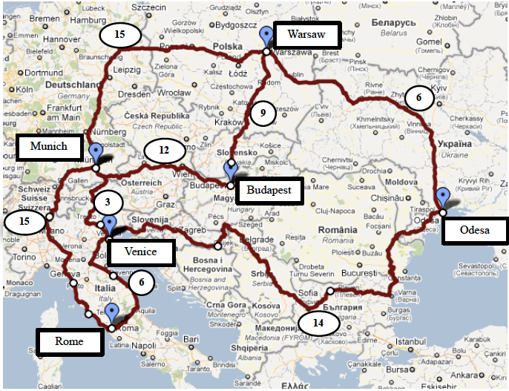
Assignment 1: Solutions
(a) DFS
W, B, M, R
(b) BFS
Order of States:
W, B, M, O, R
Path:
W, M, R

Slide 4
Assignment 1: Solutions
(c) UCS
Order of States:
W, O, B, M, V, R
Path:
W, M, V, R
(d) Greedy
W, M , R
(e) A*
Order of States:
W, M, B, O, V, R
Path:
W, M, V, R

Slide 5
Assignment 1: Solutions
(f) The Heuristic is Admissible!
h(Odesa) = 20 hrs,
h(Budapest) = 12 hrs,
h(Munich) = 3 hrs,
h(Venice) = 3 hrs,
h(Rome) = 0 hrs,
h(Warsaw) = 30 hrs.
Heuristic shouldn’t be higher than the actual cost (not lowest cost) of reaching the goal

Slide 6
Recap
Search
Uninformed Search
Informed Search
CSP
Ordering
MRV, Degree, Least Constraining Value
Fitering
Forward Checking
Arc Consistency

Slide 7
Today’s Outline
Adversarial Search (or Game playing)
Minimax Algorithm
α-β pruning
Expectiminimax Algorithm
In class Assignment

Slide 8
Games vs. Search problems
Search Problem
Bad heuristics → slow solution,
e.g. A* will take twice as long to reach the solution
Games
Bad solution → loses badly

Slide 9
Types of Games
Many different kinds of games!
Adversarial Games
Win of one player is a loss of another
Type of Game AI is most interested in
Physical games such as ice hockey, cricket, baseball etc. are much more complicated
“Robot soccer” is probably the only physical game that has attracted the interest of the AI community

Slide 10
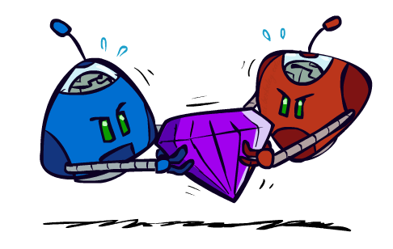
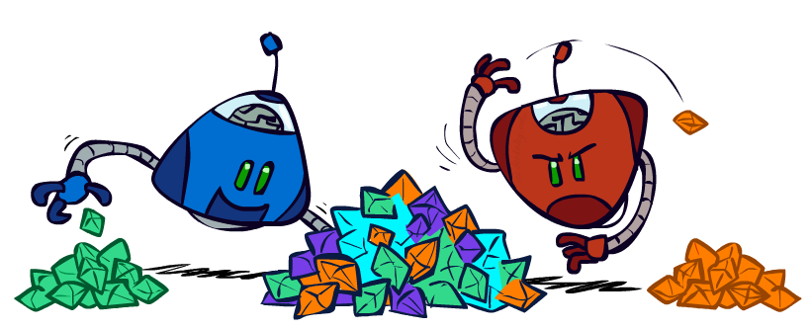
Zero-Sum Games
General Games
Agents have independent utilities (values on outcomes)
Cooperation, indifference, competition, and more are all possible
More later on non-zero-sum games
Zero-Sum Games
Agents have opposite utilities (values on outcomes)
Lets us think of a single value that one maximizes and the other minimizes
Adversarial, pure competition

Slide 11
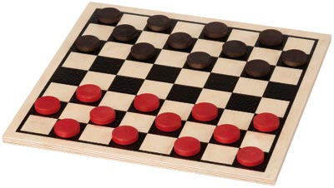
Game Playing State-of-the-Art
Checkers:
1950: First computer player.
1994: First computer champion: Chinook ended 40-year-reign of human champion Marion Tinsley using complete 8-piece endgame.
2007: Checkers solved!

Slide 12
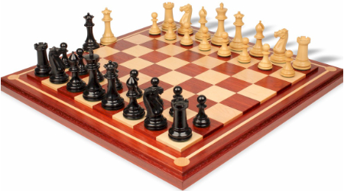
Game Playing State-of-the-Art
Chess:
1997: Deep Blue defeats human champion Gary Kasparov in a six-game match.
Deep Blue examined 200M positions per second, used very sophisticated evaluation and undisclosed methods for extending some lines of search up to 40 ply.
Current programs are even better, if less historic.

Slide 13
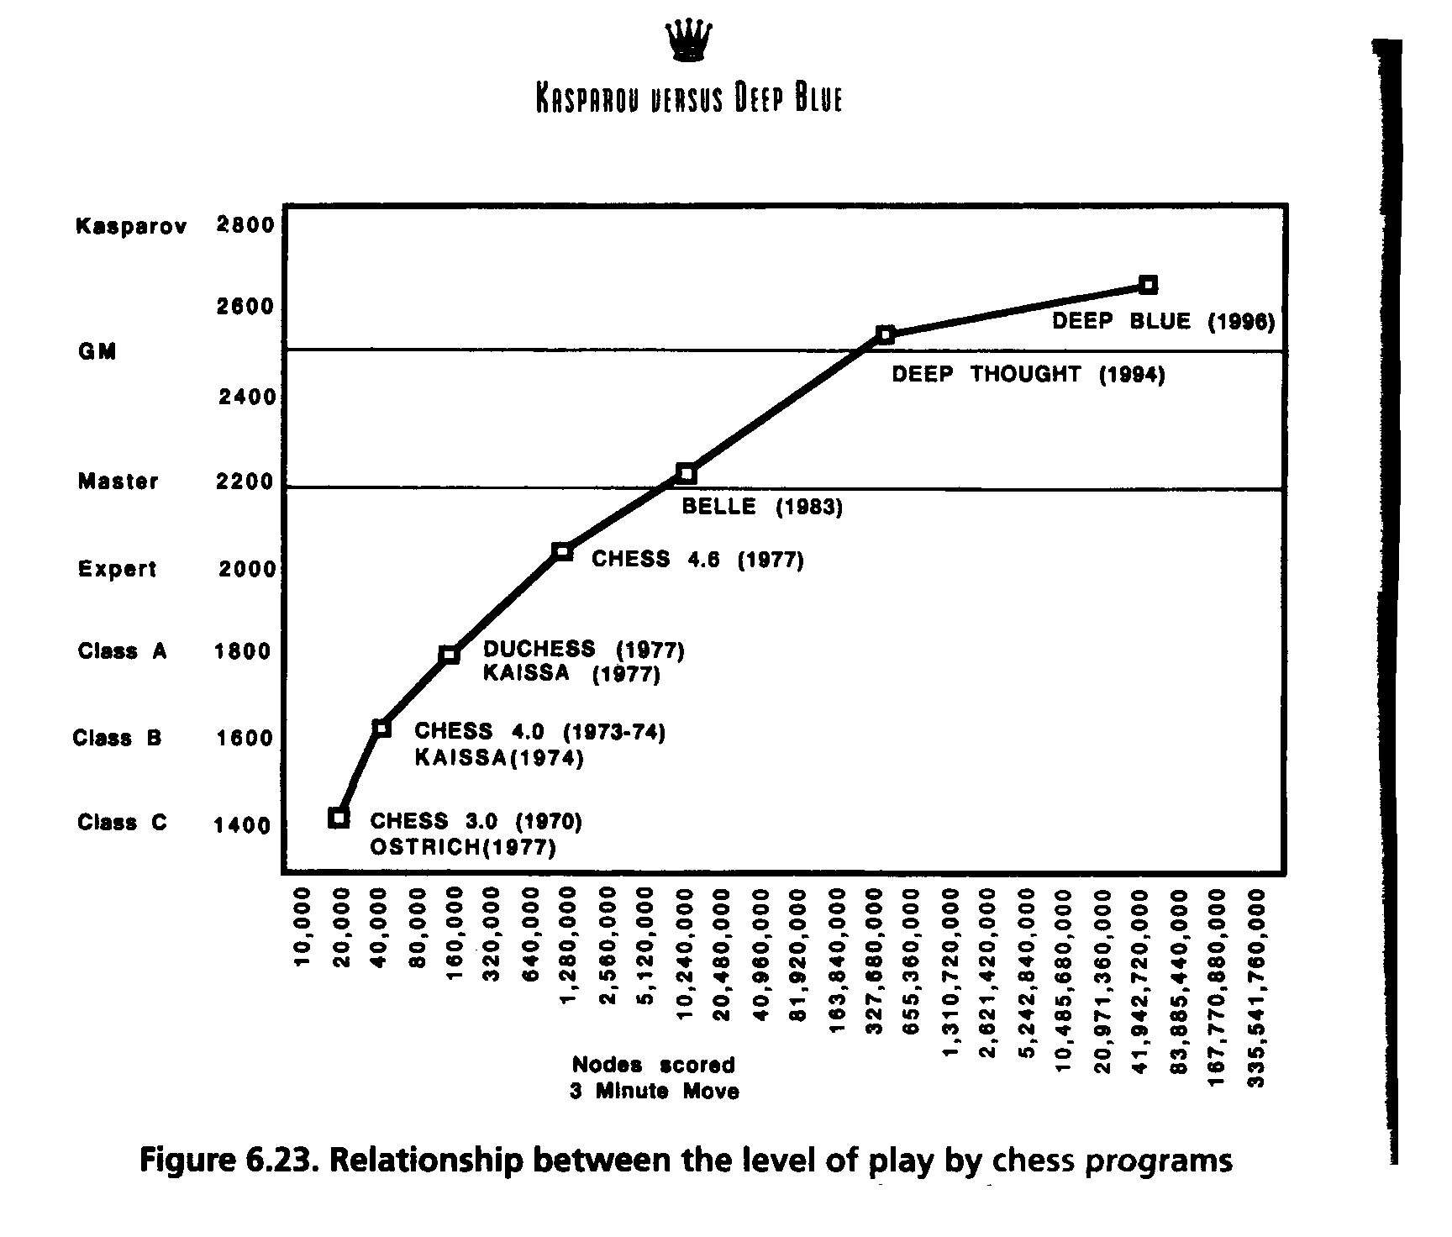

Slide 14
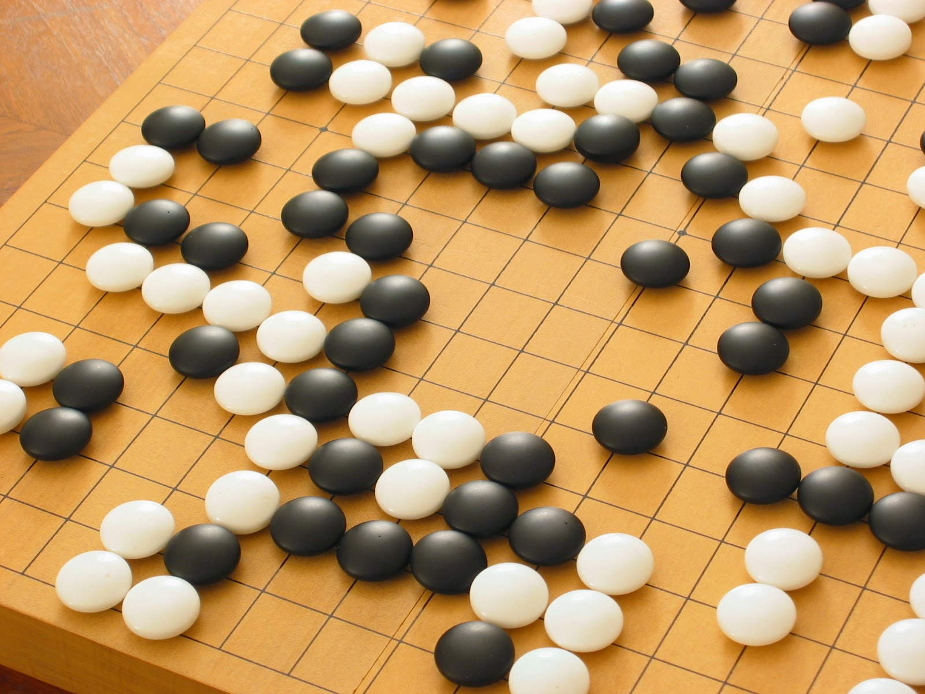
Game Playing State-of-the-Art
Go:
In October 2015, AlphaGo became the first Computer Go program to beat a professional human Go player without handicaps on a full-sized 19×19 board.

Slide 15
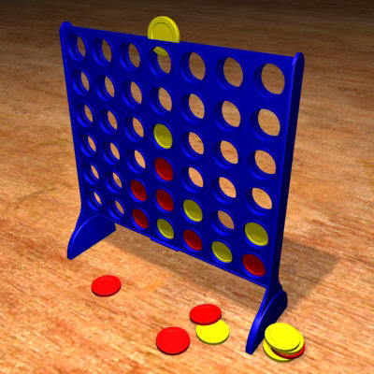
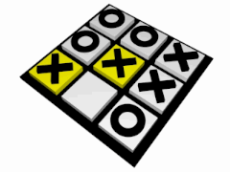
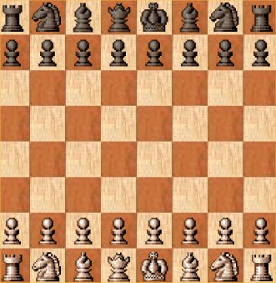
Traditional Board Games
Finite
Two-player
Zero-sum
Deterministic
Perfect Information
Sequential
Notes:
The field of game theory deals with games in a very general sense
In this talk, we will focus on the “classic” board games that fit the above criteria, which already throw up some interesting challenges
Imperfect information – “chance” is involved
perfect info – all is visible, imperfect – all isnt visible – eg, cards in hand

Slide 16
Terminology
Perfect information:
All information is visible to all players at all times – e.g. Chess, Checkers, etc.
Imperfect information:
Some information is not visible to all players e.g. Poker, Bridge etc.
Zero Sum Games
One players’ win is the other player’ loss

Slide 17

Adversarial Search

Slide 18
Formal definition of a game:
Initial state
Successor function: returns list of (move, state) pairs
Terminal test: determines when game over
Terminal states: states where game ends
Utility function (objective function or payoff function): gives numeric value for terminal states
We will consider games with 2 players (Max and Min)
Max moves first.

Slide 19
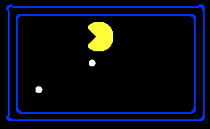
Single-Agent Search Trees
8
2
0
…
2
6
…
4
6

Slide 20
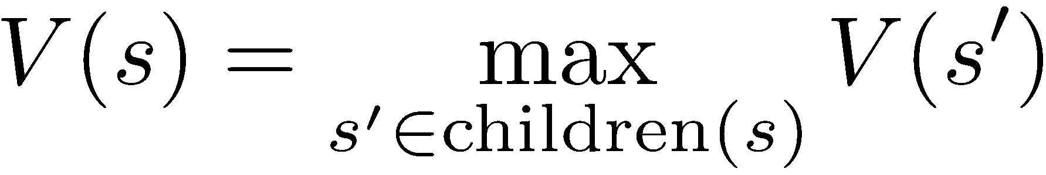
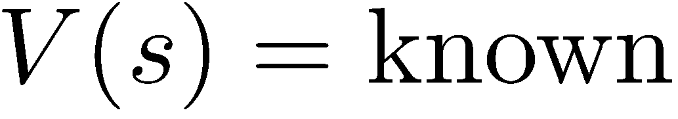
Value of a State
Non-Terminal States:
Value of a state: The best achievable outcome (utility) from that state
8
2
0
…
2
6
…
4
6
Terminal States:

Slide 21

Adversarial Game Trees
-20
-8
…
-18
-5
…
-10
+4
-20
+8

Slide 22
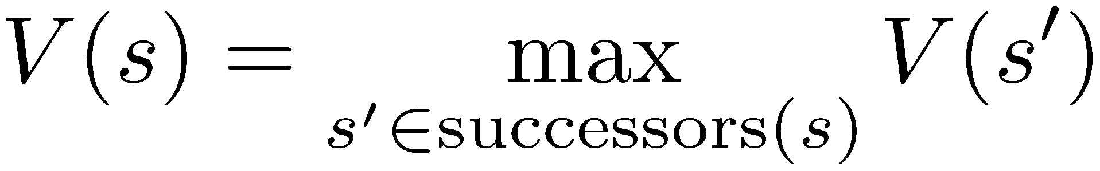
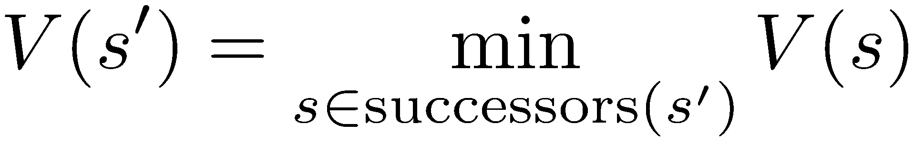
Minimax Values
States Under Agent’s Control:
States Under Opponent’s Control:
-8
-5
-10
+8
Terminal States:

Slide 23
Key Idea: Look Ahead
3x3 Tic-Tac-Toe
optimal play
We start 3 moves per player in:
X’s turn
O’s turn
X
loss
loss

Slide 24
Look-ahead based Tic-Tac-Toe
X’s turn
O’s turn
X
Tie
Tie
Tie
Tie

Slide 25
Look-ahead based Tic-Tac-Toe
X’s turn
O’s turn
Win for O
Win for O
Tie
Tie
Tie
Tie

Slide 26
Look-ahead based Tic-Tac-Toe
X’s turn
O’s turn
Win for O
Win for O
Tie
Tie
Tie
Tie

Slide 27
Look-ahead based Tic-Tac-Toe
X’s turn
Win for O
Tie
Win for O
O’s turn
Win for O
Tie
Tie
Tie
Tie
Win for O

Slide 28
Each board in game tree gets unique
game tree value (utility; -1/0/+1)
under optimal rational play.
E.g. 0 for top board.
X’s turn
Win for O
Tie
Win for O
Approach:
Look first at bottom tree. Label bottom-most boards.
Then label boards one level up, according result of best possible move.
… and so on. Moving up layer by layer.x
Termed the Minimax Algorithm
Implemented as a depth-first search

Slide 29

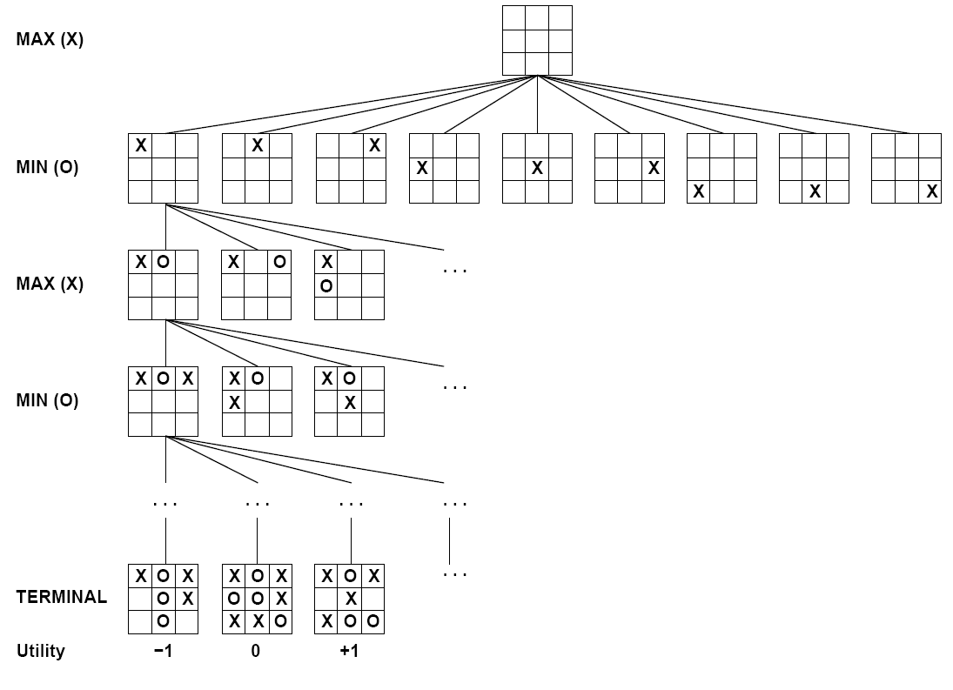

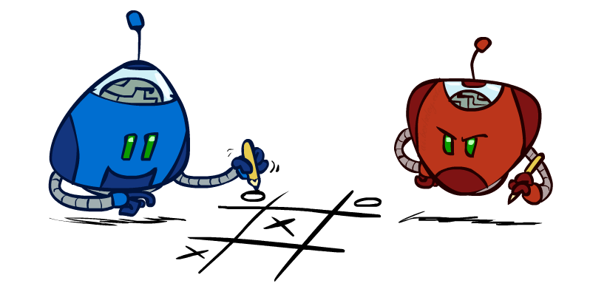
Tic-Tac-Toe Game Tree
Notes:
What is a state?
How many states does this have? 9!

Slide 30
Adversarial Search (Minimax)
Deterministic, zero-sum games:
Tic-tac-toe, chess, checkers
One player maximizes result
The other minimizes result
Minimax search:
A state-space search tree
Players alternate turns
Compute each node’s minimax value: the best achievable utility against a rational (optimal) adversary
Minimax values: computed recursively
5
max
2
5
min
8
2
5
6
Terminal values: part of the game

Slide 31
Minimax Implementation
def max-value(state):
initialize v = -∞
for each successor of state:
v = max(v, min-value(successor))
return v
def min-value(state):
initialize v = +∞
for each successor of state:
v = min(v, max-value(successor))
return v

Slide 32
Minimax Implementation (Dispatch)
def value(state):
if the state is a terminal state: return the state’s utility
if the next agent is MAX: return max-value(state)
if the next agent is MIN: return min-value(state)
def max-value(state):
initialize v = -∞
for each successor of state:
v = max(v,
value(successor))
return v
def min-value(state):
initialize v = +∞
for each successor of state:
v = min(v, value(successor))
return v
Notes:
Pick an order for two reasons: sequential processor and pruning

Slide 33
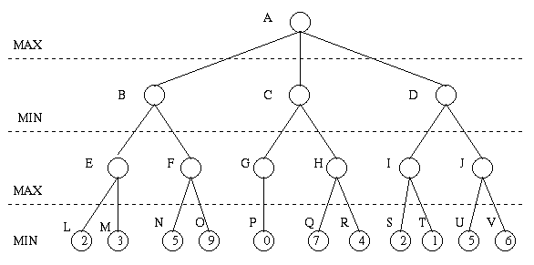
Minimax Algorithm
Payoff for Max

Slide 34
Minimax Algorithm (cont’d)
3
9
0
7
2
6
Payoff for Max

Slide 35
Minimax Algorithm (cont’d)
3
0
2
3
9
0
7
2
6
Payoff for Max

Slide 36
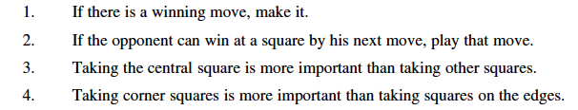
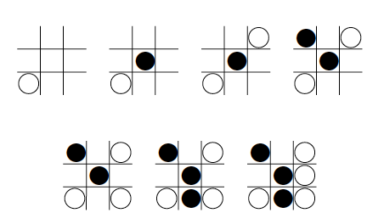
Well… Why not use a strategy / knowledge, as humans do?
Consider for Tic-Tac-Toe:
Sounds reasonable… right?
Oops!!
Consider
Black uses
the strategy…

Slide 37
So, although one can capture strategic knowledge of many games in high-level rules (at least to some extent), in practice any interesting game will revolve precisely around the exceptions to those rules!
Issue has been studied for decades but research keeps coming back to game tree search (or most recently, game tree sampling).
Currently only one exception: reinforcement learning for backgammon.
A very strong board evaluation function was learned in self-play.
Represented as a neural net.
Almost no search remained.

Slide 38
Minimax Efficiency
How efficient is minimax?
Time: O(b^{m})
Space: O(bm)
Example: For chess, b ≈ 35, m ≈ 100
Exact solution is completely infeasible
But, do we need to explore the whole tree?

Slide 39
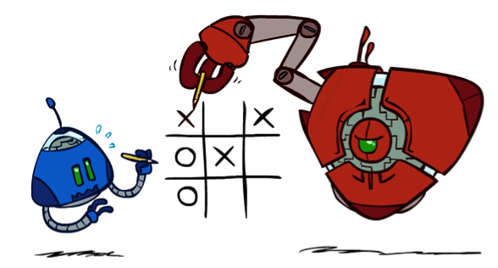
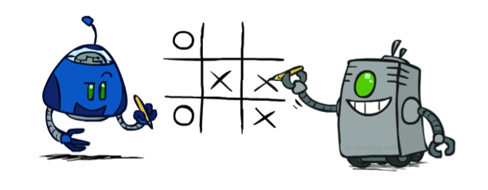
Minimax Properties
max
min
10
10
9
100
Optimal against a perfect player. Otherwise?

Slide 40

Demo Min vs. Optimal Max

Slide 41
Demo: Min vs. Suboptimal Max

Slide 42

Resource Limits

Slide 43
Look-ahead based Chess
Can we run Minimax for chess?
X’s turn
White’s turn
Black’s turn
O’s turn
X

Slide 44
How big is this tree?
~35 moves per position
~80 levels deep
Approx. 10^120 > Number of atoms in the observable universe (10^80)
We can really only search a tiny, miniscule faction of this tree!
Around 60 x 10^9 nodes for 5 minute move. Approx. 1 / 10^70 fraction.

Slide 45
Resource Limits
Solution: Depth-limited search
Instead, search only to a limited depth in the tree
Replace terminal utilities with an evaluation function for non-terminal positions
Example:
Suppose we have 100 seconds
Can explore 10K nodes / sec
So can check 1M nodes per move
α-β reaches about depth 8 – decent chess program
Guarantee of optimal play is gone
More plies makes a BIG difference
Use iterative deepening for an anytime algorithm
max
4
-2
4
min
-1
-2
4
9
?
?
?
?
Notes:
Ply = turn

Slide 46
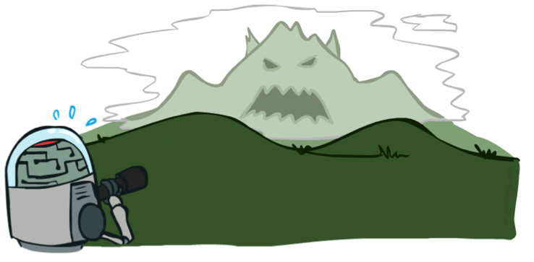

Depth Matters
Evaluation functions are always imperfect
The deeper in the tree the evaluation function is buried, the less the quality of the evaluation function matters
An important example of the tradeoff between complexity of features and complexity of computation

Slide 47
Video of Demo Limited Depth (2)

Slide 48
Video of Demo Limited Depth (10)

Slide 49
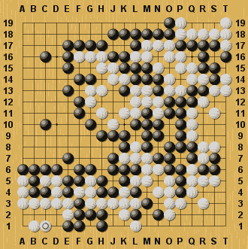
Minimax Limitations?
Two important factors for success:
Deep look ahead
Good heuristic function
Are there games where this is not feasible?

Slide 50
Minimax Limitations?
Two important factors for success:
Deep look ahead
Good heuristic function
Are there games where this is not feasible?
Looking 14 levels ahead in Chess ≈ Looking 4 levels ahead in Go

Slide 51
Minimax Limitations?
Two important factors for success:
Deep look ahead
Good heuristic function
Are there games where this is not feasible?
Looking 14 levels ahead in Chess ≈ Looking 4 levels ahead in Go
Moves have extremely delayed effects

Slide 52
Minimax Limitations?
Two important factors for success:
Deep look ahead
Good heuristic function
Are there games where this is not feasible?
Looking 14 levels ahead in Chess ≈ Looking 4 levels ahead in Go
Moves have extremely delayed effects
Minimax players for GO were very weak until 2007…but now play at master level. Since 2015, at Expert level

Slide 53
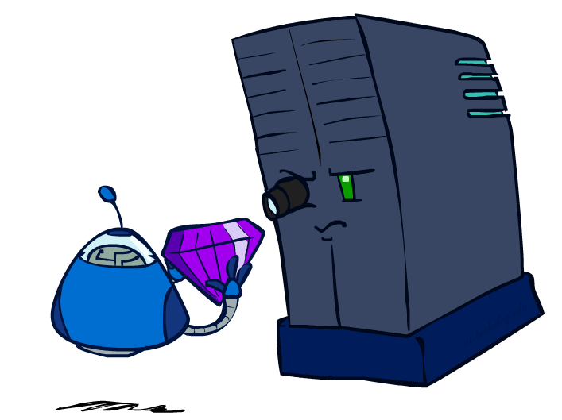
Evaluation Functions

Slide 54
Evaluation Function
Performed at search cutoff point
Must have same terminal/goal states as utility function
Tradeoff between accuracy and time → reasonable complexity
Accurate
Performance of game-playing system dependent on accuracy/goodness of evaluation
Evaluation of nonterminal states strongly correlated with actual chances of winning

Slide 55
Evaluation Functions
Evaluation functions score non-terminals in depth-limited search
Ideal function: returns the actual minimax value of the position
In practice: typically weighted linear sum of features:
e.g. f₁(s) = (num white queens – num black queens), etc.

Slide 56
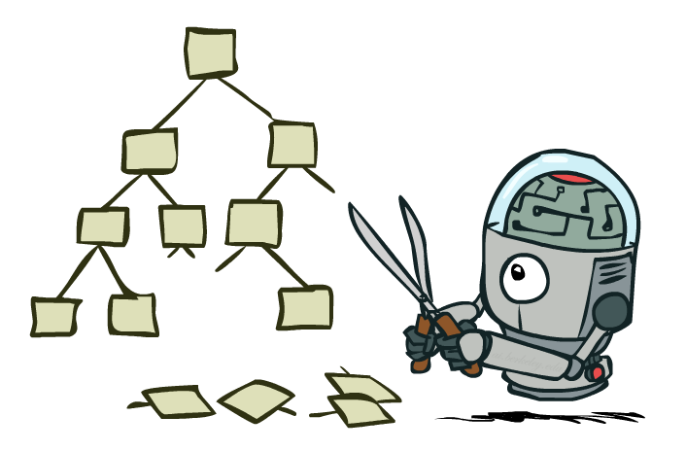
Game Tree Pruning

Slide 57
Minimax Algorithm with α-β Pruning
Payoff for Max

Slide 58
Minimax Algorithm with α-β Pruning
3
9
0
7
2
6
Payoff for Max

Slide 59
Minimax Algorithm with α-β Pruning
3
0
2
3
9
0
7
2
6
Payoff for Max

Slide 60
Minimax Algorithm with α-β Pruning
>= 3
(DFS left to right)
3
<= 0
<= 2
3
0
Prune!
2
Prune!
3
9
0
7
2
6
Payoff for Max

Slide 61
Minimax Example
3
12
8
2
4
6
14
5
2

Slide 62
Minimax with Pruning
3
12
8
2
14
5
2

Slide 63
Alpha-Beta Pruning
General configuration (MIN version)
We’re computing the MIN-VALUE at some node n
We’re looping over n’s children
n’s estimate of the childrens’ min is dropping
Who cares about n’s value? MAX
Let a be the best value that MAX can get at any choice point along the current path from the root
If n becomes worse than a, MAX will avoid it, so we can stop considering n’s other children (it’s already bad enough that it won’t be played)
MAX version is symmetric
MAX
MIN
a
MAX
MIN
n

Slide 64
Alpha-Beta Implementation
α: MAX’s best option on path to root
β: MIN’s best option on path to root
def max-value(state, α, β):
initialize v = -∞
for each successor of state:
v = max(v, value(successor, α, β))
if v ≥ β return v
α = max(α, v)
return v
def min-value(state , α, β):
initialize v = +∞
for each successor of state:
v = min(v, value(successor, α, β))
if v ≤ α return v
β = min(β, v)
return v
Notes:
Pick an order for two reasons: sequential processor and pruning

Slide 65
Alpha-Beta Pruning Properties
This pruning has no effect on Minimax value computed for the root!
Good child ordering improves effectiveness of pruning
With “perfect ordering”:
Time complexity drops to O(b^{m/2})
Doubles solvable depth!
Full search of, e.g. chess, is still hopeless…
This is a simple example of metareasoning (computing about what to compute)
max
min
10
10
0

Slide 66
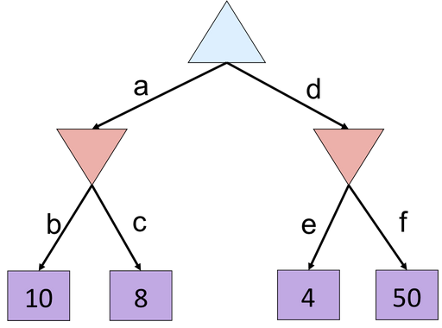
Alpha-Beta Quiz

Slide 67
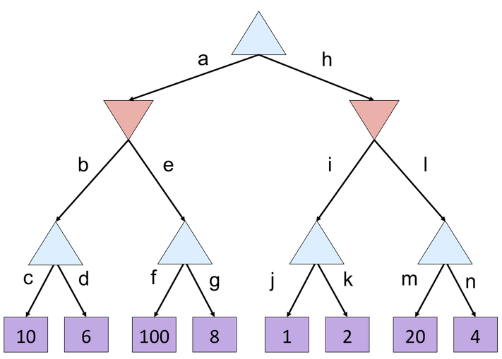
Alpha Beta Quiz 2

Slide 68
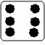
When Chance is involved: Backgammon Board

Slide 69
Expectiminimax
Generalization of Minimax for games with chance nodes
Examples: Backgammon, bridge
Calculates expected value where probability is taken (More in Section 3 of this class)
Over all possible dice rolls/chance events
- Max and Min nodes determined as before
- Chance nodes evaluated as weighted average

Slide 70
Game Tree for Backgammon
…
…
…
…
…
…
…
…
…
C
…
…
…
…
…
…
…
…
…
Notes:
Have to include chance nodes in addition to MIN and MAX nodes.
Branches leading from chance nodes denote possible dice rolls and each is labeled with the probability that it will occur (36 ways to roll the dice, but only 21 distinct rolls 6-5 is the same as 5-6)
How should we calculate MINIMAX value? Can only calculate the average or expected value taken over all possible dice rolls.
Lots more about this, if interested send me email for references.

Slide 71
Expectiminimax
Expectiminimax(n) =
Utility(n) | for n, a terminal state
 | for n, a Max node
 | for n, a Min node
 | for n, a chance node

Slide 72
Expectiminimax
.9 * 2 + .1 * 3 = 2.1
Small chance at high payoff wins.
But, not necessarily the best thing
to do!
Notes:
Obvious extension to the algorithm, as in minimax, is to cut off the search at some depth, and apply an evaluation function to each leaf.
Unlike minimax, however, it is not enough for the evaluation function to just give higher scores to better positions. The presence of chance nodes means that one has to be more careful...
Evaluation function assigns values of 1, 2, 3, 4 to the leaves: move a-1 is best. Evaluation function that preserves the ordering of the leaves (values of 1, 20, 30, 400) will select a-2. The algorithm behaves completely differently if we make a change in the scale of some evaluation values.
To avoid this behavior, the evaluation function must be a positive linear transformation of the probability of winning from a position.
Another problem with expectiminimax: very expensive!! Where minimax is O(b^{m}), expectiminimax is O(b^{m} n^{m}) where n is the number of distinct rolls.

Slide 73
Next Time: Logic and Reasoning!
NOW – In Class Assignment 2

